Slide 1

Opportunities in Information Technology for Entrepreneurship & Wealth Creation
Prof Amos DAVID
Lorraine University, FRANCE

Slide 2
Outline
Overview of the IT environment in Nigeria
  Evolution in IT
  Any cultural and/or psychological evolution ?
Opportunities in identification and creation of services
The concept of Competitive Intelligence (Economic Intelligence)
Existing initiatives
  By government agencies (Federal and State governments)
  By Non-Governmentail Organizations
Enhancing best ptractice in Nigeria
Conlucion

Slide 3
Clarification of the topic

Slide 4
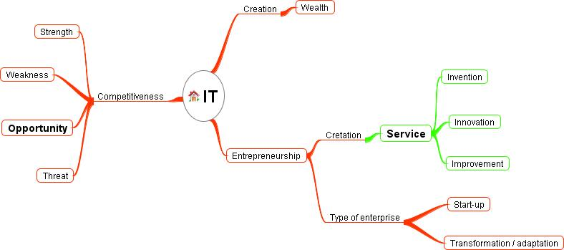
Complexity of the topic

Slide 5
Evolution in IT and their impacts

Slide 6
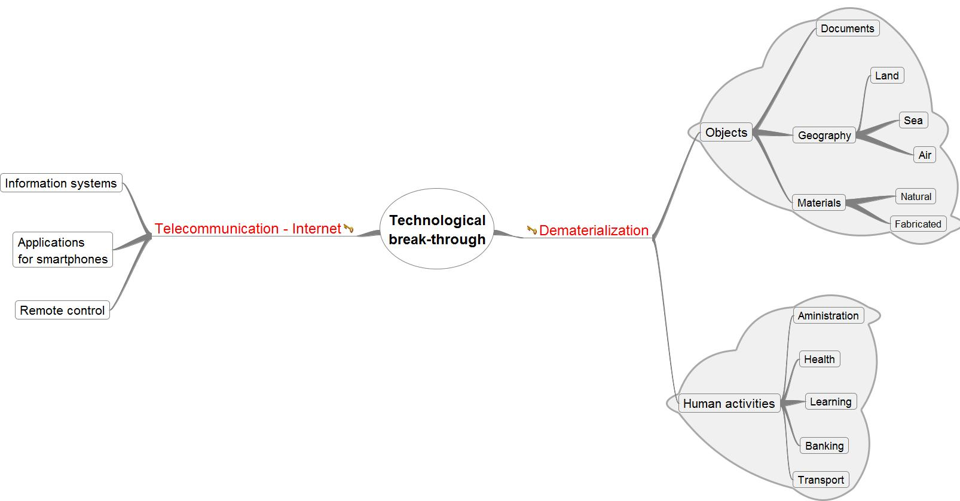
Technological break-through

Slide 7



Production and distribution of - books
Author
Production
Diffusion
Editor
Bookshop
Selection
Access
Management
Documentary database
Library
Access
User

Slide 8
Production and distribution of Videos
(films, documentary, events, etc.)
Author
Production
Diffusion
Producer
Distributor
Selection
Access
Management
Cinematheque
Cinema hall
Access
User
Phenomenon of Home Cinema

Slide 9
Dematerialized human activities
Interpersonal communication
  Elimination of distance barrier
  Elimination of time factor
Diffusion / publication
  Publication of anything, anywhere, anytime
Administrative procedures
  Organization enhancement
  Traceability of activities
Financial transactions
  Payment
Training
  E-learning
Medicine
  Tele-medecine
Etc.

Slide 10
Evolution of (mobile) telecommunication services

Slide 11
Example 1 : Evolution in Mobile Telecommunication
In the 1990s
Three hours to travel from my village to the nearest access to telephone
Three hours back to the village
In terms of wealth creation
  For the entrepreneurs (the telephone operator and the call center): they are assured of clients because of the benefits that the users can derive from the service.
  For the user : he has the opportunity of spending less for making phone calls, has more time for other activities since he doesn’t have to travel long distance for making his calls, contribute to road safety since he will have the opportunity of reducing his movement by road.
  For the government, the tax to be paid by the telephone operator will create another source of revenue. Also the operator at the call center will contribute in reducing unemployment.

Slide 12
Example 2 : Money transaction
Bank transfer
  Outside working hours
  Instant notification
  Beneficiary can make use of the transaction instantly
Mobile Phone recharge
  Purchase of recharge card
  Scrape the code
  Key the code
  Now
    Recharge through bank transfer

Slide 13
Example 2 : Visa processing
Time saving: (transport, delivery time, response time, etc.)
Money saving: (transport cost, material cost, environmental cost, etc.).
Improved security: (transportation, transactions, trace of activities, etc.)

Slide 14
Notable trend
Producer / Developer
Intermediary
Consumer / Client

Slide 15
Any Cultural / psychological evolution

Slide 16
Any cultural / psychological evolution ?
Observation of Lord Fredrick Daltry LUGARD in 1926
“In character and temperament, the typical African of this race-type is a happy, thriftless, excitable person, lacking in self-control, discipline, and foresight. … His thoughts are concentrated on the events and feelings of the moment, and he suffers little from the apprehension for the future or grief for the past. …. He will work hard with a less incentive than most races.”
  http://www.vanguardngr.com/2013/02/c-e-n-t-e-n-a-r-y-the-way-nigerians-are-by-lugard/, 9/2/2013

Slide 17
Opportunities in identification and creation of services

Slide 18
Design and administration of services
Decision-maker
Entrepreneur/
Government/Collectivity
Design
Implementation
Evaluation
Service
Beneficiaries
Population/Citizen
Awareness
Exploitation
Assessment

Slide 19
Example in agriculture
The phase of design of a service by the decision-maker
If we consider the role of the administrator in charge of agriculture in the government structure, we expect that one of his main tasks would be the identification of the farmers’ problems as related to the farmers’ activities. The administrator may adopt one of the following attitudes:
  Refuse to identify the farmers’ problems through observation, that is, refuse to observe the farmers’ problems.
  Observe the farmers’ problems; perceive the problems but for one reason or another doesn’t consider them as problems for which solutions should be sought.
  Perceive the farmers’ problems and consider that the problems should be solved.

Slide 20
The DM decides to provide services to the farmers
The phase of implementation
  The objective could be to provide the necessary information for the various phases of the farmer’s activities
    Land preparation
    Planting
    Weeding
    Harvesting
    Marketing
    Etc.
The phase of evaluation
  Feedback can be obtained through questionnaires, group of discussion and through frequently asked questions.
  The IT literate population is actually familiar with the services already available using the Web 2.0 technology, allowing feedback from users

Slide 21
On the beneficiary’s side
The phase of awareness
  IT can be used to inform the farmers of the available services.
The phase of exploitation
  Access information for direct exploitation
  Analyze information for value added information – knowledge creattion/generation from information
The phase of assessment
  The assessment phase concerns mainly the beneficiary’s point of view on the service provided. This is generally measured compared to his information need.
  There is need to pay special attention to this phase since it is directly connected to the phase of design by the decision-maker. This explains why the need of the potential beneficiary should be integrated when designing the service either through the observation of their needs or through the past experience of the decision-maker.

Slide 22
The concept of Competitive Intelligence (Economic Intelligence)

Slide 23
In Japan
MITI (Ministry of International Trade and Industry)
  Japanese believe that “It is in sharing of knowledge that development is enhanced”
  In the western countries “Secret is power”

Slide 24
In the USA
CIA
  The Intelligence Cycle
    When we’re tasked with a specific project, we follow a five-step process called the Intelligence Cycle. This process ensures we do our job correctly as we work through a system of checks and balances.
Collection
      Planning and Direction
Processing
      Analysis and Production
Dissemination

Slide 25
Intelligence cycle at CIA
Planning and Direction
  When we are tasked with a specific job, we begin planning what we’ll do and how. We move in a specific direction to get the job done, listing what we know about the issue and what we need to find out. We discuss ways to gather the necessary intelligence.
Collection
  We collect information overtly (openly) and covertly (secretly). Reading foreign newspapers and magazine articles, listening to foreign radio, and watching overseas television broadcasts are examples of “overt” (or open) sources for us. Other information sources can be “covert” (or secret), such as information collected with listening devices and hidden cameras. We can even use space-age technology like satellite photography. For instance, some analysts could actually view how many airplanes are present at a foreign military base by looking at a picture taken from a satellite in space.

Slide 26
Definition of CI
CI is the organizational function responsible for the early identification of risks and opportunities in the market before they become obvious. Experts also call this process the early signal analysis.
Key points of this definition:
  Competitive intelligence is an ethical and legal business practice, as opposed to industrial espionage which is illegal.
  The focus is on the external business environment
  There is a process involved in gathering information, converting it into intelligence and then utilizing this in business decision making.

Slide 27
Contributions of CI to socio-economic structures
As regards decisional problems (DP)
  Decisional process
    Resolving DP using the process of CI
As regards information relevance
  Evaluation of information
  Evaluation of an information system

Slide 28
In terms of scientific research

Slide 29
Scientific study of CI
"The scientist is not the man who provides the real answers. He is the one who asks the right questions" - Claude Levi-Strauss

Slide 30
Problematic areas in CI
Decompose CI ➔ CI process
What are the issues in each of the CI process ?

Slide 31
CI viewed as a process
Identification of needs in the form of problems to solve or stakes (threat, risk, danger)
  ➔ How can a DP be specified ?
Identification of the types of necessary information to obtain the result
  ➔ Transforming the DP into information problems
Identification and validation of the relevant information sources
Collection and validation of information relevant information
  ➔ Do relevant sources produce relevant information ?
Processing of the information collected for the calculation of indicators
  ➔ How are collected information structured and stored ?
Interpretation of the indicators
  Who does the interpretation ?
  On what are the interpretations based?
Decision making for the resolution of the identified problem

Slide 32
Early spotting of opportunities : From 1990s to date
IT Penetration through mobile telecommunication in Nigeria

Slide 33
Extract n° 1
Vodacom Nigeria says potential for 40 million mobile users
Friday 16 January 2004 | 09:55 CET | News
Vodacom believes that the potential number of mobile phone subscribers in Nigeria could be double the current estimate of 20 million users. As a result, up to four operators would be able to compete within the market. According to Alan Knott-Craig, the Nigeria market is big enough to support both Vodacom and MTN (S Africa), mobile operator which entered the Nigerian market in 2001. Vodacom believes that Nigeria has the potential to be as big as S Africa, where the market potential is 25 million-30 million users by 2007-2009, compared to 17 million users at present. The biggest obstacle to Vodacom establishing itself in Nigeria is strict US anti-corruption legislation, which Telkom and SBC Communications must comply with.
http://www.telecompaper.com/news/vodacom-nigeria-says-potential-for-40-million-mobile-users, 2004-01-16

Slide 34
Extract n° 2
Nigerian telecom market to hit $10b in 2010
Written by Henry Umoru
Thursday, 30 October 2008
Federal government has projected that the market value of the nation’s telecommunication industry would hit a total of $10 billion by 2010.
Speaking at the opening of the 5th edition of “Bridges Across Borders” (BAB) conference held at the NICON Luxury Hotel, Abuja, Minister of Commerce and Industry, Engr. Charles Ugwuh who noted that the current 50 million telecom subscriber base with the current value put at $5 billion per annum, said the Nigerian average spending on telephone service is about N2, 570 per month.
The Conference is being organized by the Nigerian Export Promotion Council (NEPC) and it participated in the event for the first time in Johannesburg, South Africa in 2006 with other 13 countries in attendance.
According to him, there is the tendency that the present 50 million subscribers will keep growing as new investors enter into the sector, just as he stressed that the liberalization of the telecommunication industry in 2001 has brought about new investment in the business environment.
http://allafrica.com/stories/200810300123.html, 2008-10-30

Slide 35
Extract n° 4
Nigeria's monthly phone calls to hit N106bn - Investigation
Monday, September 24, 2012
By BISI OLALEYE
Nigeria's telecommunications subscribers monthly expenditure on mobile phone calls, according to checks, would soon hit a whopping N106.1 billion by the end of December, 2012. The call expenditure forecast is a conservative calculation based on the current industry Average Revenue Per User (ARPU) and the projection by experts in the industry that stipulated that active telecoms subscribers would have grown higher than what the telecoms companies currently have on their respective networks.
Former Executive Vice Chairman, Nigerian Communications Commission (NCC), Ernest Ndukwe, has predicted during the Nigerian Telecoms Awards, organized by Logica Group recently, that active telephone subscriptions in the country would surpass 105 million in the next three months, including December 2012. However, according to the latest statistics for the month of July 2012, released by the NCC, there are about 103 million telecoms subscribers currently on all the telecoms networks in the country.
While the industry ARPU in Nigeria was estimated at around N1,011, according to the Business Monitor International Limited (BMI), and subscriber base of 103 million in the month of July, the outgoings by Nigerian subscribers in July was conservatively valued at N104 billion monthly. ARPU is the financial benchmark used globally by telecoms companies to measure the average monthly or yearly revenue generated from an average subscriber. The expenditure increased from N100 billion in January 2012 when active industry subscriber base was estimated at 99 million by the NCC, to reach N104 billion in seven months after into the month of July when subscriber base hit 103 million.

Slide 36
Extract n° 4 …
With the industry projection by Ndukwe on the industry records,telcos will have 105 million active telecoms subscribers by the end of December, 2012, and with industry ARPU of N1,011, Nigerians subscribers are billed to spend an average of N106 billion monthly. The projected expenditure is also equivalent to the average monthly revenue from phone calls, which will accrue to the telecoms firms, including the Global System for Mobile Communications networks such as MTN, Globacom, Airtel, Etisalat; the Code Division Multiple Access operators of Visafone, Capcom (MultiLinks , Starcoms), dormant Zoom Mobile, as well as the fixed line operators.
Elaborating on the boom in subscriber growth since 2011 telecoms deregulation that was undertaken by the Federal Government, Ndukwe said no one was in a position to predict in those early days of GSM licensing, the full potential of the market and the speed at which the Nigerian telecom network would grow. However, he stressed that, "Today, the figure for active subscribers in the mobile networks is around 100 million lines and is likely to surpass 105 million by end of December 2012. "Nigeria has transited from what I described as the telecommunications dark ages before 2000 to a telecommunication revolution age that has opened up new possibilities and frontiers across our political social and economic landscape."

Slide 37

Extract n° 5
Friday, October 5, 2012
Active mobile telephone lines now 105.2 million
by Dayo Oketola
The country's mobile telephone subscriber base has continued to record strong growth with the number of active mobile telephone lines hitting 105.2 million in August, the latest subscriber data released by the Nigerian Communications Commission has revealed.
The data, which was released on Thursday, revealed that mobile network operators in the country added over 1.8 million new lines in August alone thereby, increasing the subscriber base from 103.4 million active telephone lines in July to over 105.2 million at the end of August 2012.
Industry analysts said the promotions currently being run by Global System of Mobile telecommunications operators in the country might have been responsible for the huge subscriber growth in August.
While the total connected lines increase to 141.2 million in the month, the NCC data showed that GSM companies such as MTN, Globacom, Airtel and Etisalat attracted most of the new subscriptions between January and August, while the Code Division Multiple Access operators such as Visafone, Multi-Links, Starcomms and ZoomMobile continued to witness month-on-month decline in combined subscriber base.
According to the NCC data, while active mobile subscriptions on the GSM networks increased from 91 million in January to 101.4 million at the end of August; the CDMA operators' subscriber base shrank from 4.4 million to 3.3 million during the eight-month period.
The GSM active subscriptions, which stood at 91 million in January, 2012, increased to 92 million in February and 94.5 million at the end of March. The subscriptions continued the upward growth trend, reaching 96.6 million in April and 97.5 million in May.
In June, July and August, the combined active GSM subsriber base increased to 98.3 million; 99.4 million and 101.4 million respectively.
However, the active subscriber base on CDMA networks continued to decline from 4,031,820 lines in February to 3,904,846 in April. It further plunged to 3,718,153 in May; 3,541,355 in June; and fell in July to 3,452,368 and finally to 3,347,716 at the end of August 2012.
The number of fixed lines, which stood at 688,333 as at January, declined to 488,088 at the end of August 2012.

Slide 38
Extract n° 5 …
While the Nigerian telecoms industry continues to experience huge growth year-in-year, it has once again defied industry forecast, with the giant leap it recorded in growth in August.
The former Executive Vice-Chairman, Nigerian Communications Commission, Mr. Ernest Ndukwe, had recently predicted that the country's mobile subscriber base would hit 105 million in December 2012.
However, the latest NCC data revealed that the target was achieved much earlier, as active subscriptions had crossed the 105 million projections, reaching over 105.2 million at end of August, 2012.
Experts said though it was good that the country's mobile subscriber base had crossed the 105 million mark, the implication was that it would put pressure on the mobile networks if the operators did not increase their network capacities.
It will be recalled that the NCC had recently fined the four GSM companies in the country to the tune of N1.17bn for poor quality of service on their networks.
With increased subscriber base, analysts, urged the operators to match this with more investments in network expansion.

Slide 39
Extract n° 6
Thursday, February 14, 2013
Subscribers spent N2.14tn on phone calls, others in 24 months
by Dayo Oketola
Active telephone subscribers in the country must have spent a whopping sum of N2.14tn on voice calls and Short Message Service, among other basic services between January, 2011 and December, 2012.
This is based on an Average Revenue per User of N912 monthly accruing from telecoms subscribers to MTN, Globacom, Airtel, Etisalat, Visafone, Starcomms, and Multi-Links, among other operators in the country.
The ARPU is a financial performance benchmark in the telecoms industry that measures the average monthly or yearly revenue generated by Global System for Mobile communications, Code Division Multiple Access and the fixed telephone operators in a particular country. Nigeria currently has 113 million active subscribers.
In view of this, telephone service subscribers, who increased from the highest of 95,886,714 in December 2011 to 113,195,951 in December 2012, would have spent N2.14tn on mobile services, particularly voice calls between January 2011 and December 2012.
While a little over N1tn was spent on telephone services in 2011, subscribers spent 1.14tn on the services in 2012.

Slide 40
Extract n° 6 …
The Nigerian Communications Commission had revealed that active telephone users in the country stood at 89,840,343 in January 2011 and at a monthly ARPU of N912, at least N81.9bn was expended on phone calls.
This increased to N82.6bn in February 2011 and N82.9bn in March, when the subscriber base hit 90,583,306 and 90,969,794, respectively.
Subscribers further spent N82.6bn in April of the same year; N82.5bn in May; N82.6bn in June; N82.8bn in July; N83.9bn in August; N85.2bn in September; N85.6bn in October; N87.4bn in November and N87.4bn in December 2011.
At that time, the subscriber base had increased to 90,834,429; 92,094,200; 93,461,436; 93,924,116 and 95,387,893 in July, August, September, October and November; closing at 95,886,714 in December. Therefore, over N1tn was spent on telephone services in 2011.
In 2012, the total estimated telephone service spending was N1.14tn as at December. Specifically, 96,150,836 active subscribers spent an estimated N87.7bn on telephone services in January. This was followed by N88.1bn in February; N90.4bn in March; and N92.2bn in April, when the subscriber base was 96,616,580; 99, 145,013; and 101,077,658, respectively.
Subscribers' telephone spending continued on an upward trend in May with N92.9bn by 101,814,533 active subscribers. This was followed by N93.4bn in June; N94.3bn in July; N96bn in August; and N97.7bn in September.
By then, subscriber base had risen from 102,369,999 in June to 107,083,036 in September 2012.
While N99.9bn was spent on telephone services in October, over 110 million subscribers expended N100.6bn in November and N103.2bn was spent in December 2012 by 113,195,951 telephone subscribers.

Slide 41
Synthesis

Slide 42
Statistics from NCC (lack of data 2001-2006)

Slide 43
Early spotting of opportunities / 2

Slide 44
Tuesday, August 28, 2012
Nigerian smartphone market to grow by 35% -Huawei
by Dayo Oketola
About 35 per cent increase is expected in sales of smartphones in Nigeria before 2015.
The Managing Director, Huawei Devices Nigeria, Mr. Tony Liangwei, said this would translate into 30 million smartphones expected to be sold in the country in the next three years.
Speaking during a workshop for mobile device dealers in Lagos on Friday, Liangwei said the expected increase in sales would be driven by the shift in the focus of Nigerian consumers from phones with basic functionality to smartphones.
This, according to him, means that in the years to come, the opportunities in the smartphone market in the country for device dealers will be much greater than what is available today.
In view of this, he said it was essential for dealers to partner with Huawei as the company was set to introduce devices that would revolutionise the mobile and Internet technology market at unbeatable prices.
Liangwei said Huawei organised the workshop to formally introduce its devices as well as to educate dealers on the background, core values and organisational culture of the phone maker.
He further explained that the technology company used the event as an opportunity to intimate dealers in Nigeria with its growth agenda.
“We want to use the workshop as a platform to encourage dealers in mobile devices to form partnerships with Huawei, which will be beneficial to all parties,” he said.
In order for dealers to key into the opportunities available in the Nigerian smartphone market, Liangwei said it was important for them to consider partnering with Huawei.
The three major product lines highlighted at the seminar were Huawei's handsets, mobile broadband and home devices.
Industry analysts have said Huawei devices should be among the most affordable considering their technology and quality.
The company produces a wide array of devices ranging from low-end mobile devices to high-end smartphones.
Liangwei said he was looking forward to a mutually rewarding partnership with the dealers and the country as a whole.

Slide 45
PUNCH January 8, 2013 by Dayo Oketola
25% of Nigerian mobile subscribers use smartphones –TNS
Only 25 per cent of Nigeria’s over 105 million mobile telephone subscribers use smartphones, global market research firm, TNS, has said in a report entitled, ‘Navigating growth in Africa.’
The report, which was authored by the Chief Executive Officer, TNS Africa and Middle East, Mr. Kim Macllwaine, and 12 other market research experts, including Mr. Aggrey Maposa, Melissa Baker and Mr. Nick Hills, revealed that Nigeria was the second biggest smarphone market in Africa, closely following South Africa.
In spite of the country’s smartphone penetration, the report revealed that 59 per cent of Nigerian phone users were still using basic feature phones, while only 16 per cent used advance feature phones.

Slide 46
Existing initiatives
To enhance IT development in Nigeria

Slide 47
Initiatives by government agencies
(Federal and State governments)
Federal Ministry of Industry, Trade and Investment
  University Entrepreneurship Development Programme (UNEDEP)’s mission is to ‘catch them young’. The programme focuses on entrepreneurship development of undergraduates and aims to create future entrepreneurs; encourage self-employment; embed business ethics among the youth and consequently reduce the incidence of poverty
    http://www.punchng.com/business/business-economy/fg-to-tackle-unemployment-with-graduate-entrepreneurship-scheme/, 22/05/13

Slide 48
Initiatives by Non-Governmental Organizations
The Co-Creation Hub
  “To aid that needed shift from consumption to creation was also why a group of young Nigerians came together to form The Co-Creation Hub, an innovation centre dedicated to accelerating the application of social capital and technology for economic prosperity in Nigeria, according to Tijani (published 21 Mar 2013). …. This move has caught the attention of local interests. The Co-Creation Hub and Tony Elumelu Foundation last year launched a Seed Fund to support 20 early stage ventures in their bid to demonstrate their technology to potential end-users. …. According to Tijani, “There are more of such initiatives from Government and private foundations in Nigeria today than ever before.” A sign that indeed, the country is on an evolving path to becoming a software producing economy. …. Among numerous challenges facing the Nigerian software developer, industry experts said the twin myths of lack of capital, and foreign software being superior to locally-produced ones top the list. According to Tijani, lack of capital is “the biggest myth in the industry for which our experience at Co-Creation Hub begs to differ. There are more funds in the market than investment ready software ventures.”
    http://www.thisdaylive.com/articles/Exploring-Nigerias-Untapped-Software-Industry/142752/, 21/05/13

Slide 49
Enhancing best practice in Nigeria
Computer Professionals – Registration Council of Nigeria (CPN)
Nigeria Computer Society (NCS)
Institute of Software Practitioners of Nigeria (ISPoN)
Information Technology Association of Nigeria (ITAN)
National Information Development Agency (NITDA)
These structures are classified by NCS as:
  Interest groups: ISPoN, ITAN
  Regulatory bodies: CPN, NITDA

Slide 50
Conclusion

Slide 51
Moving forward
Already, according to Nigerian Communications Commission (NCC), the percentage contribution of telecoms to GDP moved from 1.27% in 2004 to 5.64% in 2012
Need for cultural evolution
Need for structuring research activities into laboratories
Need for research and development partnering
Wealth is not only for the entrepreneurs as individuals but also to the governments and collectivities. It could be a motivating factor to start an enterprise, but problem solving should be as motivating as wealth creation. In many cases, wealth comes when solutions to concrete problems are proposed – therefore providing relevant services

Slide 52
Need for international collaborations
With Research and Training Intitutions (Universities, Laboratories, Foundations, etc.)
With Professional bodies
  Example NITPF (Nigerian IT Professionals in France)

Slide 53
Thanks for your attenton

