Slide 1
Fighting corruption with Emerging Technologies
Ayodeji Rex Abitogun mncs, mcpn
Lead Consultant/CEO, Management Edge Limited
rex@managementedgeltd.com

Slide 2
Presentation Outline
Background
Understanding Corruption
FACTS- Nigeria Corruption Index
Categories of Corruption
Cost and Consequences Of Corruption
Tackling Corruption with Technologies
Key Stakeholders
Application Areas for IT Professionals
Key Considerations
Limitations

Slide 3

Background
It is evident in Nigeria today that the costs of corruption for economic, political and social development is becoming increasingly high. Many of the most convincing arguments in support of the fight against corruption are little known to the public and remain unused in political debates. This presentation provides evidence that reveals the true cost of corruption and explains why governments and businesses must prioritise the use of Information Technology (IT) tools in fighting corruption.

Slide 4

Corruption defined
…….dishonest or illegal behaviour, especially of people in authority.
                ---- Advance Learners Dictionary
…….the abuse of public or private office for personal gain.
                ---- CleanGovBiz

Slide 5
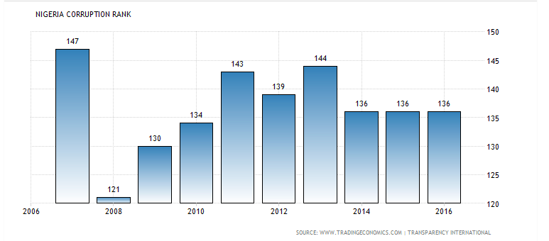
FACTS- Nigeria Corruption INDEX
The 2016 Corruption Perceptions Index reported by Transparency International ranked Nigeria 136 out of 175 least corrupt countries in the world.
Corruption Rank in Nigeria averaged 119.14 from 1996 until 2016, reaching an all-time high of 152 in 2005 and a record low of 52 in 1997.

Slide 6
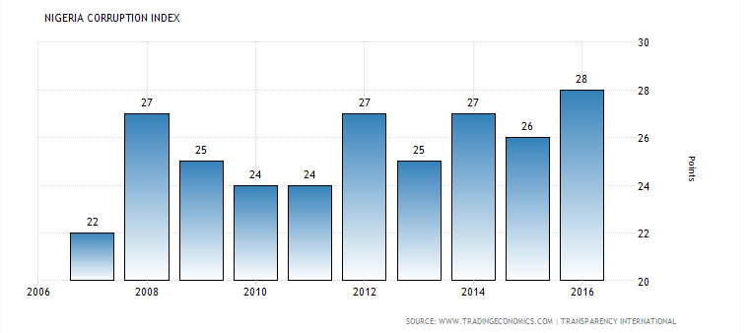
Facts (Contd’.)
In terms of Score, Nigeria scored 28 points out of 100 on the 2016 Corruption Perceptions Index. Corruption Index in Nigeria averaged 20.17 Points from 1996 until 2016, reaching an all-time high of 28 Points in 2016 and a record low of 6.90 Points in 1996.

Slide 7
Categories of Corruption
Grand Corruption
Petty Corruption
Political Corruption

Slide 8

Cost of CORRUPTION
Political Cost
Economic Cost
Social Cost
Environmental Cost

Slide 9
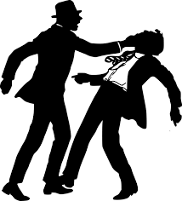
Consequences OF Corruption
Reputational Damage
It increases transaction costs and uncertainty.
It inhibits the efficient allocation of resources
It weakens entrepreneurship -- kills innovation
It excludes poor people from public services and perpetuates poverty
It corrodes public trust, undermines the rule of law and ultimately delegitimises the state

Slide 10



Tackling Corruption WITH TECHNOLOGY
Technology today provides a more cost effective ways to report corruption as well as facilitate the lodging of complaints by key stakeholders through websites, hotlines or phone applications and present it in a more meaningful form to citizens
Ever than before, the Social media is helping citizens to report corruption in real-time and anonymously. Through crowdsourcing and mobile technology applications, stakeholders can now compile evidence, store, track and take action.

Slide 11
Stakeholders involve in Fighting Corruption
ICT Professionals
Govt.
CSO
Private
Org.
Citizens
Int’l Community
Judiciary

Slide 12
Applications Areas
IT have the potential to make a significant contribution to the fight against corruption. By facilitating the flow of information between government institutions (G2G), between government and citizens (G2C), as well as among citizens(C2C), new technologies can promote transparency, accountability and civic participation (Chene, 2011). Technology can be made relevant in the following areas;
Monitoring and Tracking
  Access to information
  Budget monitoring
  Monitoring of political life
  Monitoring of social services
  Monitoring of the judiciary

Slide 13
Applications Areas
Data collection – e.g Ureporters collecting data trough SMS
Social mobilisation – C2G interaction
  Citizen mobilisation e.g. #SubsidyMustGo #OpenNASS, #BringBackOurGirls
E-government initiatives
  E-procurement
  E-taxation
  E-judiciary
  Electronic identification
  Financial transactions e.g TSA

Slide 14
Considerations in Solution Development
Solution Objective
The People
The Process
The Partners
Platform
Engagement

Slide 15
Limitations
Relevant Skills Shortage- Setting the goal, Data Gathering and Analysis, Designing the System and Maintaining the system including the security.
Possible misuse of ICTs:- For example, they can be used to disseminate misinformation and incite violence. Ensure that you have the means and access to shut down the platform if faced with a hostile situation.
Internet Access:- The cost of internet is still on the high side. This may prevent large of number of citizens from using technology solutions.
Security Challenges: A poorly designed system stand the risk manipulation. Participants identity can be exposed or their messages intercepted.

Slide 16

Case Studies
Publish What You Pay (PWYP) is a global membership-based coalition of civil society organisations (CSOs) in over forty countries (including Nigeria) united in their call for an open and accountable extractive sector, so that oil, gas and mining revenues improve the lives of women, men and youth in resource-rich countries and that extraction is carried out in a responsible manner that benefits countries and their citizens.

Slide 17
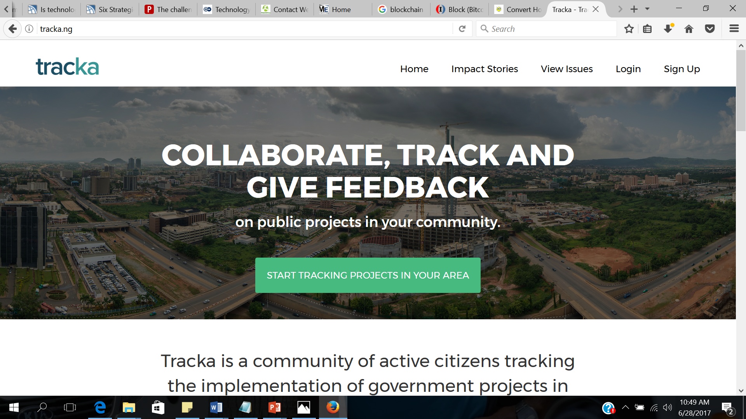
Budgit
Tracka is a community of active citizens tracking the implementation of government projects in their community to ensure service delivery.
Tracka is a BudgIT initiative with support from OSIWA, Omidyar Network, UNDEF and MAVC

Slide 18
Conclusion
It is no doubt that corruption is an epidemic globally and IT professionals working with other stakeholders have a major role to play in fighting this social menace by coming up with appropriate solutions that will aid in identifying, tracking, monitoring and reporting every corrupt practices. In Nigeria, the Computer Professionals (Registration Council of Nigeria), CPN must encourage and promote the development of innovative technologies to combat this social menace.

Slide 19
Thank you

Slide 20
References
Chêne Marie, Use of mobile phones to detect and deter corruption (2012), http://www.u4.no/publications/use-of-mobile-phones-to-detectand-deter-corruption/
http://www.oecd.org/cleangovbiz/
http://www.oecd.org/corruption/crime/

